Slide 1

Automating SQL Server Workflows with GitHub Actions and Azure Functions
Introductory slide for a presentation about using GitHub Actions and Azure Functions to automate SQL Server management tasks.

Slide 2




Understanding GitHub Actions
GitHub Actions allows automating workflows
Workflows are defined in YAML files
Triggers can start workflows automatically
Actions are reusable building blocks
GitHub Actions is a platform that allows creating workflows to build, test, package, release and deploy code.
The workflows are defined in YAML files checked into the code repository to track changes.
Workflows can be triggered by various events like push, pull request, schedule etc to run automatically.
GitHub provides many prebuilt actions that can be reused to perform common tasks in a workflow.
GitHub Actions is a powerful automation platform that allows creating workflows triggered by events to automate tasks in the software development lifecycle.

Slide 3
Understanding Azure Pipelines
Azure Pipelines allow automating workflows
Pipelines are defined in YAML files
Triggers can start pipelines automatically
Jobs, Steps, Tasks are reusable building blocks
Azure Pipeline is a platform that allows creating workflows to build, test, package, release and deploy code.
The pipeline are defined in YAML files checked into the code repository to track changes.
Pipelines can be triggered by various events like push, pull request, schedule etc to run automatically.
There are many prebuilt actions that can be reused to perform common tasks in a pipeline.
Azure Pipelines is a powerful automation platform that allows creating workflows triggered by events to automate tasks in the software development lifecycle.

Slide 4

So they are the same?

Slide 5



GitHub Actions for SQL Server
Create GitHub repository
Add SQL Server connection details
Define GitHub Actions workflow
Trigger workflow on push
Create a new GitHub repository to store the GitHub Actions workflow.
Store SQL Server connection details like server name, database name, username and password as secrets in the GitHub repository settings.
Write a YAML workflow file that executes SQL scripts against the SQL Server database using the connection details.
Configure the workflow to trigger on git push events to run the SQL scripts automatically.
Notes:
Change this to reflect sql project example

Slide 6
Azure Functions: An Overview
What are Azure Functions?
Serverless compute service that enables you to run code on-demand without having to explicitly provision or manage infrastructure
Benefits of Azure Functions
Scalable, event-driven, cost-effective, fully managed platform
Use cases with SQL Server
Process data from SQL Server, automate tasks, integrate with other services

Slide 7
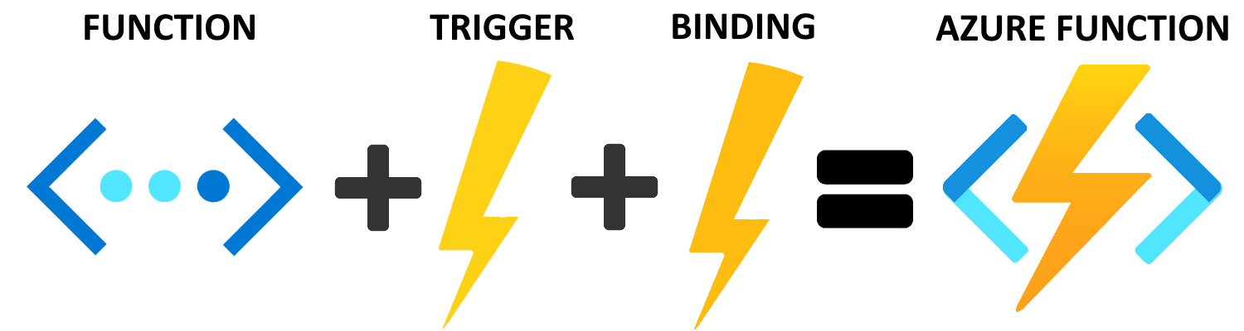
Notes:
Azure functions is a service that allows us to run bits of code in the cloud without worrying about the infrastructure it runs on. This means we can worry more about the code we're writing and less about building out servers to host it. No need to configure IIS for these! In this presentation we'll learn all about these magical little things, we'll talk about what we can use them for and how to create them and get them deployed into Azure. By the end of today you should all feel confident in building and deploying bits of code into the cloud.

Slide 8



Use GitHub Actions to trigger Azure Functions
Combining GitHub Actions and Azure Functions
Pass data between GitHub Actions and Azure Functions
Orchestrate complex workflows using both tools
Notes:
Open issue → get data → call api → inserted into SQL Database

Slide 9
“Curiosity may have killed the cat, but it keeps asking questions and finding answers. Ask questions, stay curious.”
TYSON YUNKAPORTA

Slide 10


Slide 11

Come back at:
00:00
Notes:
Add a timer? Or agenda here

